Slide 1
Midterm Presentation
EML 4552C/EEL 4914C- Senior Design
Google Mobile App for Compressor Performance (GE)

Slide 2
Scope of the Project
Customer Needs
Transfer data wirelessly to an Android phone.
Assembly time less than 5 minutes.
No modifications to pipes; non-intrusive method.
Software must collect, store and display data.
Working Demo.
Diagnostic tools are already being used by GE for compressor performance, but they are…
Too expensive
Time Consuming
Hazardous to Technical Support
Create an non-intrusive flow velocity measurement system to interface with a Google mobile phone application
Notes:
Customer Needs
Transfer data wirelessly to an Android phone.
Assembly time less than 5 minutes.
No modifications to pipes.
Software must collect, store and display data.
Working Demo.

Slide 3
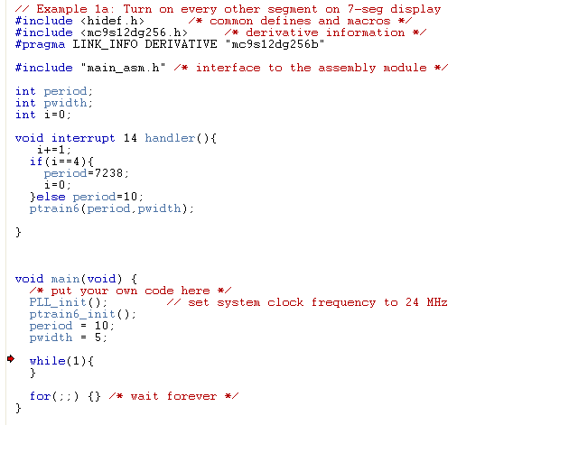
Sensor Update
Utilized the DragonBoard to output signal to ultrasonic transducers
Calls 16-bit up counter
with resolution of
1.5 MHz
Close enough to
start testing
Using basic low level
functions for fast
accurate signal
reproduction

Slide 4
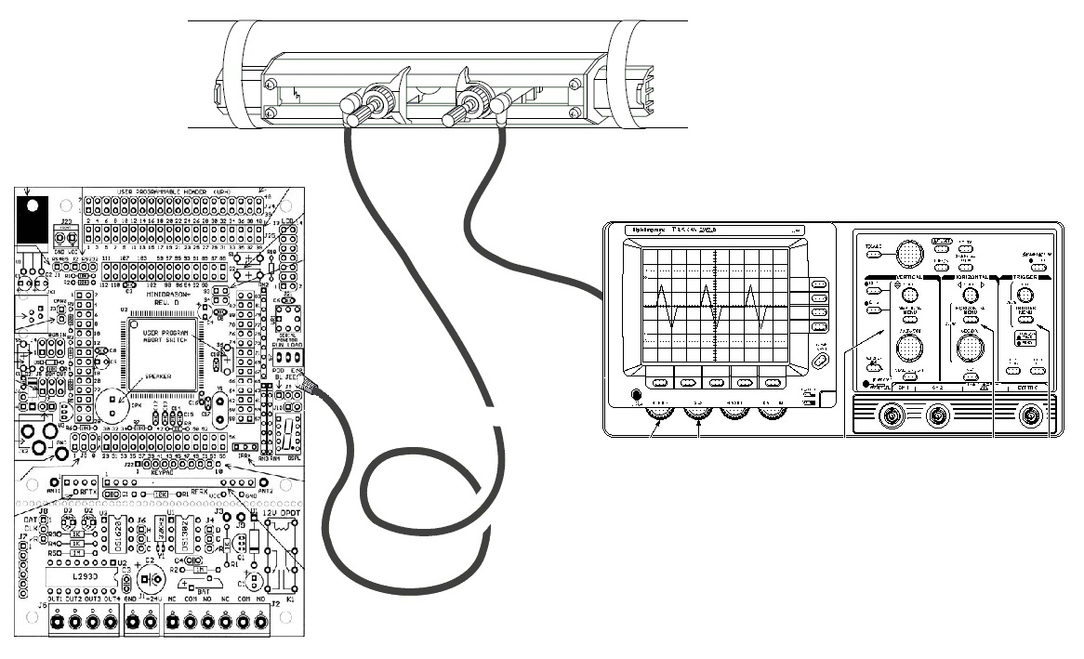
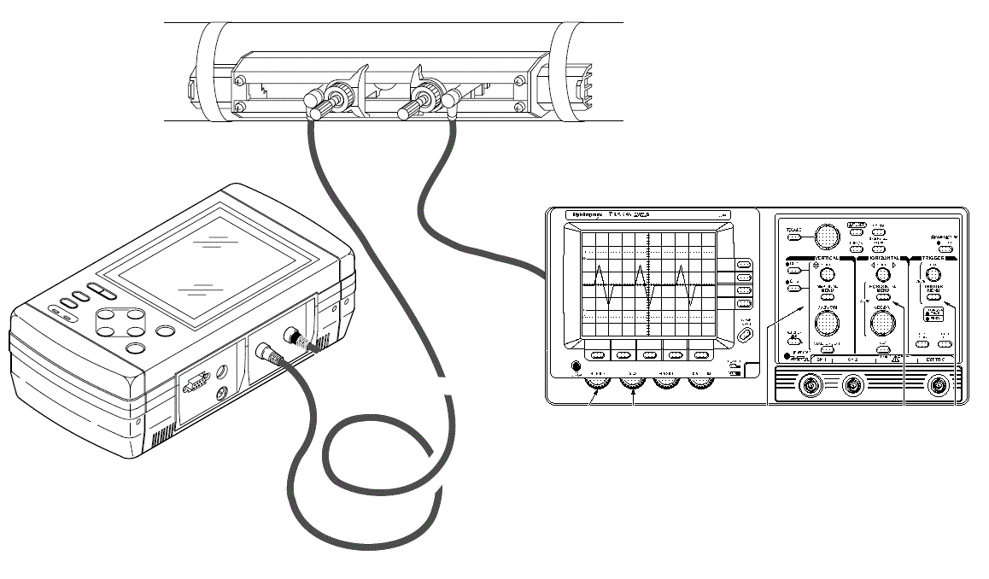
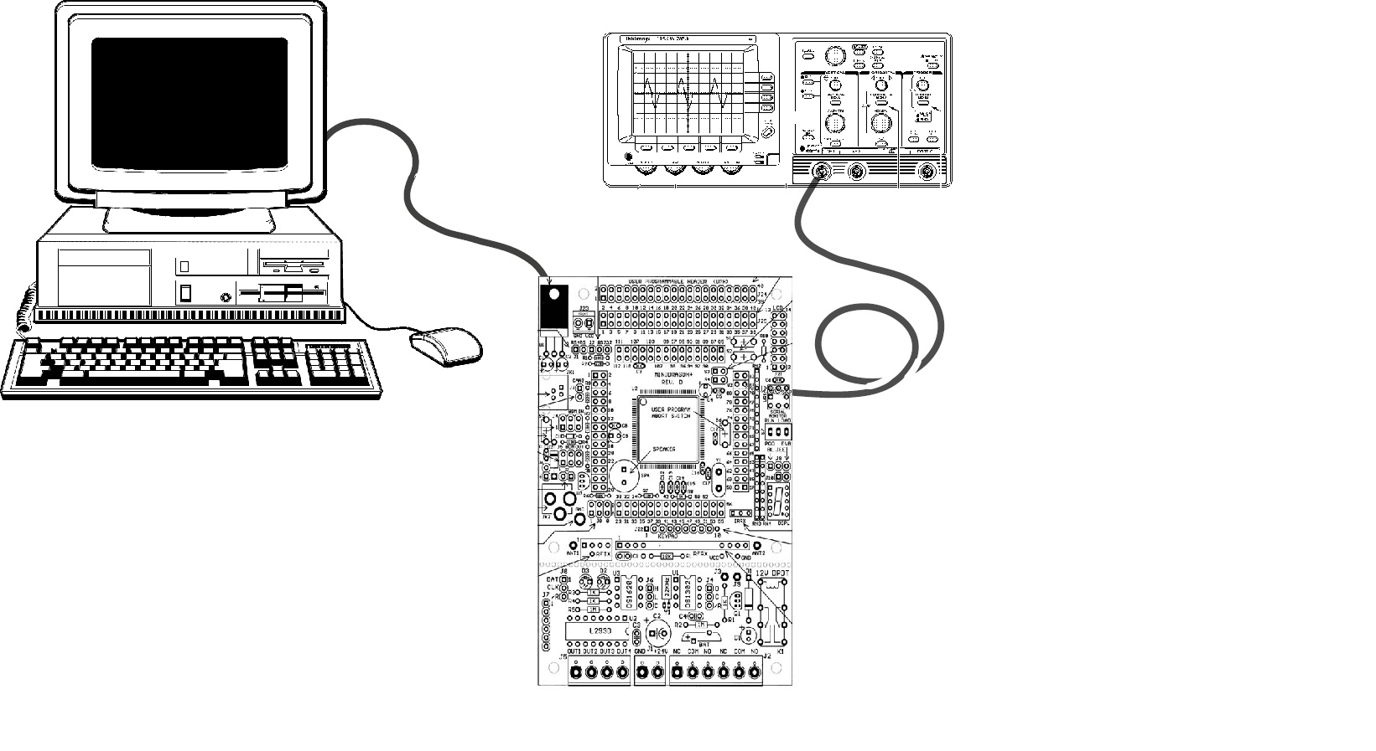
Experimental Setup

Slide 5
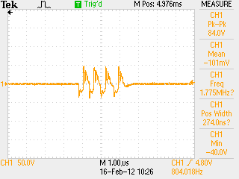
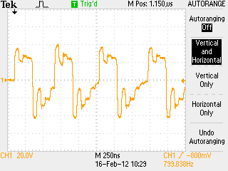
Flow Meter Output
Burst of four square waves with 250 ns period
Multiple bursts located 500 µs apart
Approximately 50V peak to peak

Slide 6
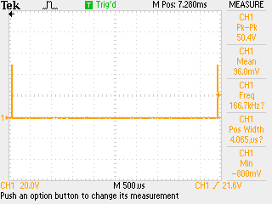
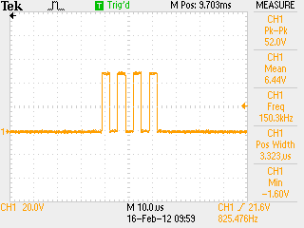
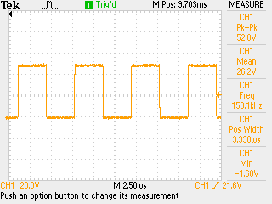
DragonBoard Output
Burst of four square waves with 2500 ns period (constraint of the TCNT)
Multiple bursts located 500 µs apart
Approximately 50 V peak to peak

Slide 7
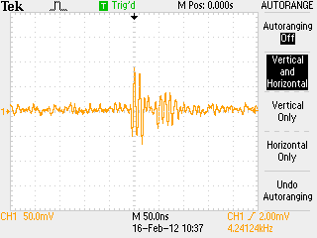
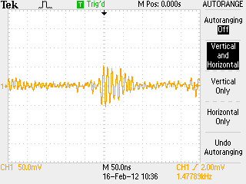
Sensor Output
Sensor output in air
Proof of concept, real testing and refinement will be done on the test apparatus
Flow Meter Output
DragonBoard Output

Slide 8
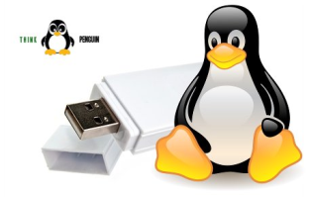
Wi-Fi on Single Board PC
Original Wi-Fi USB adapter shipped from Technologic Systems did not support master mode with Linux driver, just Ad-Hoc.
Problem: Most Android phones do not connect to Ad-Hoc networks with out rooting your phone.
Solution: New Wi-Fi module ordered:
Penguin Wireless N USB Adapter for GNU/Linux

Slide 9
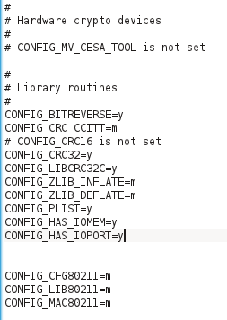
Wi-Fi on Single Board PC
Problem: Penguin adapter drivers require Linux kernel 2.6.37+. Technologic Systems only supports up to Linux kernel 2.6.34. (Most board components such as the SD Card are buggy on newer kernels)
Solution: Cross compile own drivers with ARM architecture for 2.6.34.
Drivers were compiled, but currently having trouble getting hostapd to work with firmware.
Hostapd is what implements access point management in order to turn the Wi-Fi module into an access point.
Matter of time. Cross compiling and transferring from Linux machine to SBC via SD Card is very time consuming.

Slide 10
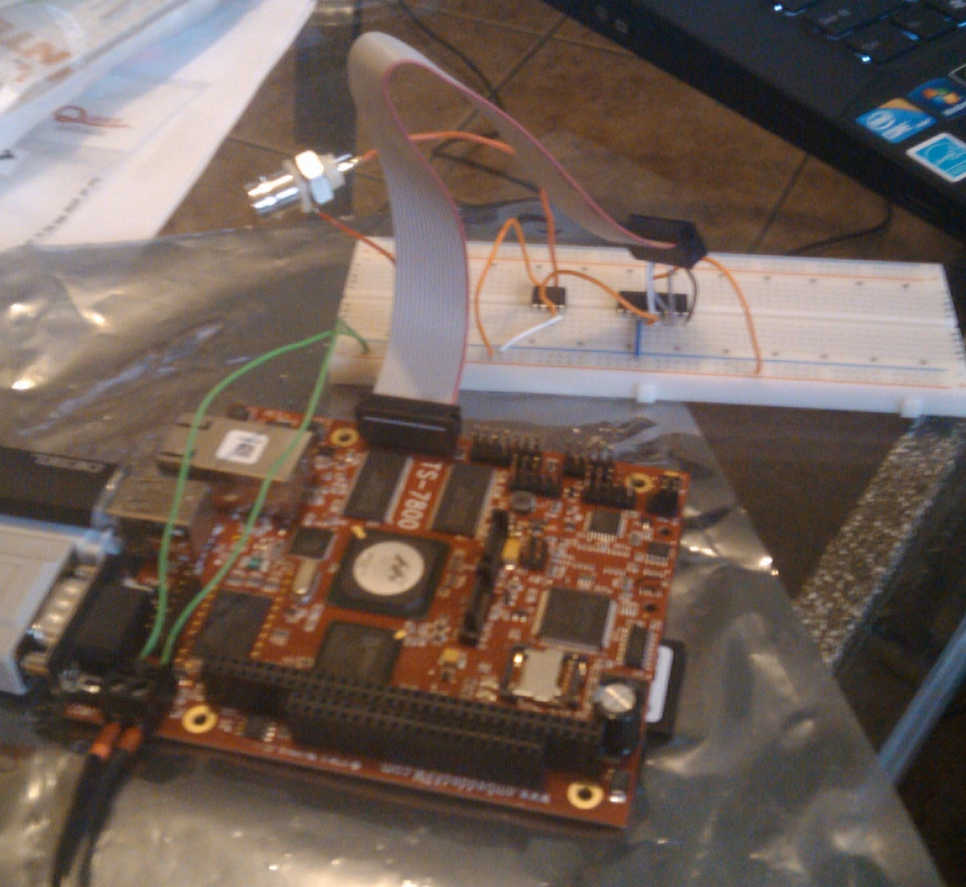
Signal Generation From SBPC
Preliminary circuit built.
Not yet tested in lab.
Still figuring out how to control Digital I/O from user space programs.

Slide 11
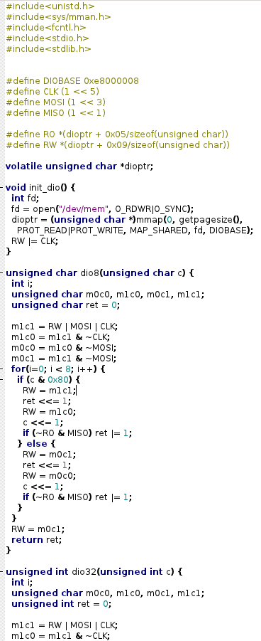
Signal Generation From SBPC
Operating System built on top of hardware => cannot access hardware directly.
Memory mapped IO is used in order to access hardware from user space.
Still figuring out how to control Digital I/O from user space programs.
mmap() system call is used in order to achieve this.

Slide 12
Flow Test Apparatus
Need a test apparatus for development, calibration, and demonstration of instrumentation and phone app
Consistent conditions needed to develop the entire system
Ability to adjust flow will aid calibration process
Our instrument ultimately needs to measure flow of natural gas (air)
Main goal is to prove the concept
We will start with a setup to measure water flow
Our transducers are tuned to operate at the higher frequency needed for liquids (due to higher speed of sound in liquid medium)

Slide 13
Flow Test Apparatus
Ball Valve
Reservoir
Pump
Steel Pipe
Transducers
Flow

Slide 14
Flow Test Apparatus
Once concept is proven, we can attempt measurement in air
Speed of sound in air is lower (1117 ft/s, vs. 4814 ft/s for water)
May or may not require transducers that operate at lower frequency
Since SBPC can handle the higher frequencies needed for liquid measurements, it can easily handle any good frequency for air

Slide 15
Mobile Application
The velocity inside the compressor pipes are expected to fluctuate by some small amount but we are only interested in large fluctuations
Need to make a running average algorithm for our incoming velocity data to normalize and eliminate small fluctuations in the data
Derived formula for the average of all points thus far at any given point

Slide 16
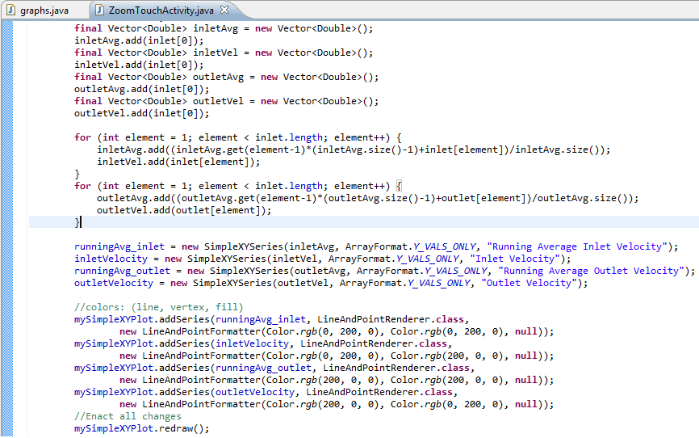
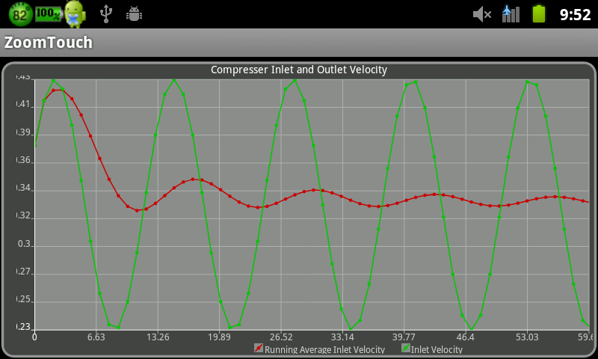
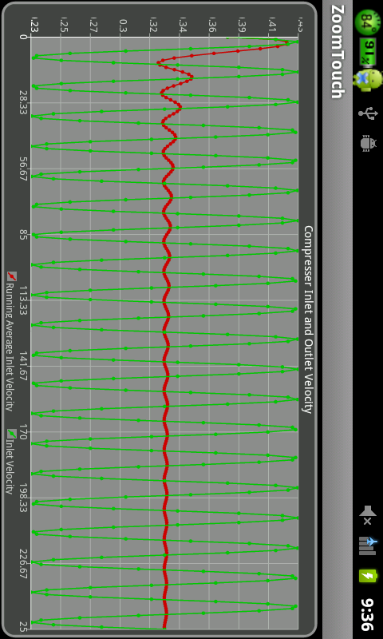
Mobile Application

Slide 17
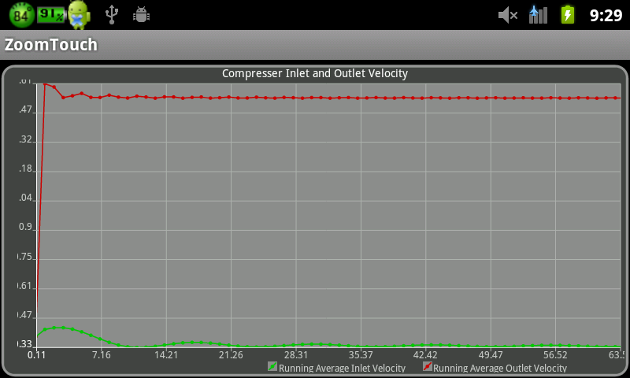
Mobile Application
Realistic Graph of what we expect our velocity measurements to look like
Includes inlet and outlet velocities
Graph also has built in zooming function which changes the x-axis
Future work will include the y-axis (i.e. full zooming into a specific point)

Slide 18
Mobile Application
Next steps: working on setting up laptop to send data to phone to use as testing tool
Will use this to test reception of the data and proper storage into the database of phone
Have been encountering difficulties with type mismatching while coding. Foresee issues with data type being stored in database and type needed for androidplot graphing functions.
Might have to modify database to store in specific data type to simplify type-conversions during the calculation and graphing stages.

Slide 19
Results from Testing the Mounting System
Satisfied second customer need
Discovered modifications needed for proper fitting Mounting System
Developed procedures for easier mounting
Unlevel attachment

Slide 20
Housing Unit Progress
Method for attaching the housing unit has been selected
Seen in figure 2, the design features four outer track grips with Keys
Dimensions for the housing unit are to be determined
Outer Track Grips
Track of
Transducers

Slide 21
Project Plan

Slide 22
Questions
Image Provided by: http://www.datingadvice4christiansingles.com/image-files/askaquestion.jpg

